Slide 1
Second phase update
Ximin Hu, Derek Mar, Nozomi Suzuki, Bowei Zhang

Slide 2
Overview
First phase:
Peak picking & assessment
Alignment & summary
Preliminary workflow integration
Second phase:
Clustering brainstorm & algorithm development
Establishment of the dilution prediction model
Multiple source tracking workflow development
Third phase:
Code testing, debugging and pack up for different versions towards user needs
Add more features

Slide 3
General Idea
Building as more as possible for users – doing ‘deletion’ during development
Modularized build-up, always possible to add more if needed
Maximum flexibility with recommended default setting
Generating report for visualization and data performance check, thus people knows what is the output explicitly
Docking towards future, all the output in a format can be further utilized for future studies

Slide 4
Clustering
Cluster the features based on behavior (proper normalization & standardization needed)
Remove noises based on cluster information
Visualize the cluster result for validation & save the result as matrix effect/chemical property tracker
Challenge:
Validation
Normalization & method optimization
Interpretability

Slide 5
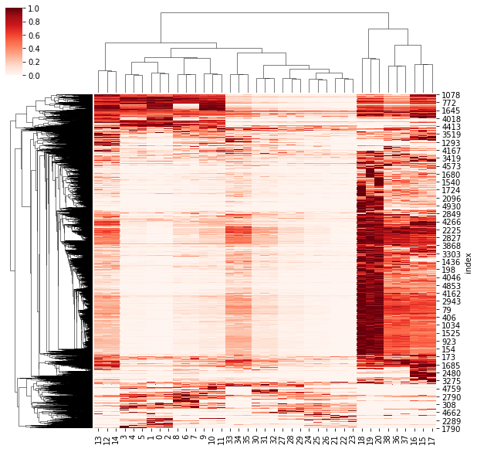
Raw heatmap

Slide 6
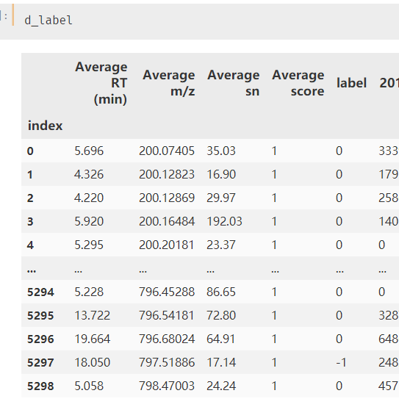
Label function

Slide 7
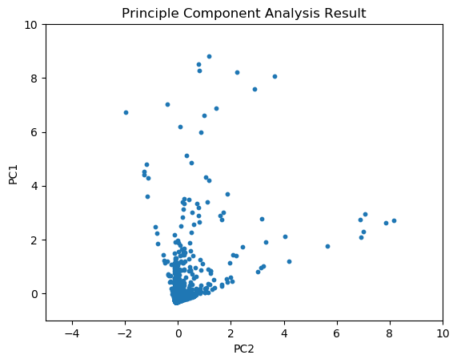
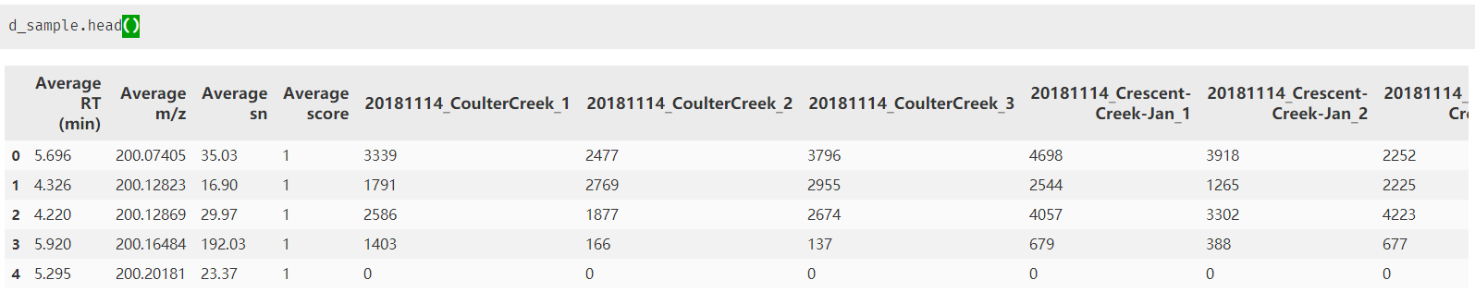
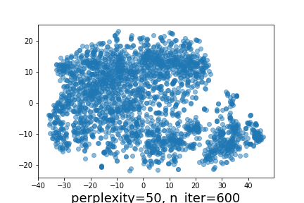
Dimension reduction

Slide 8
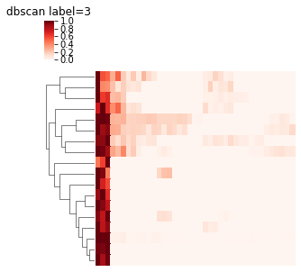
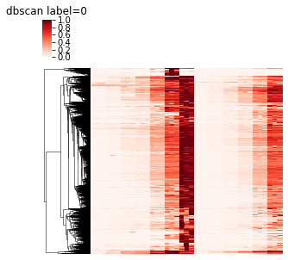
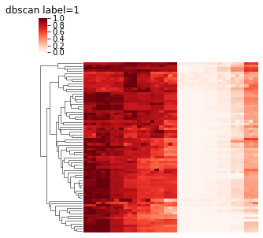
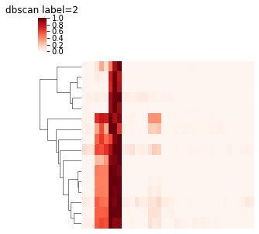
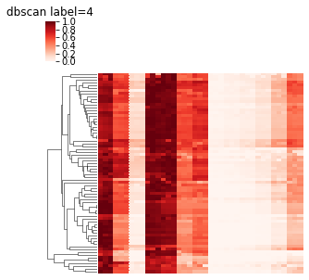
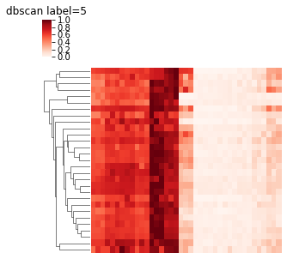
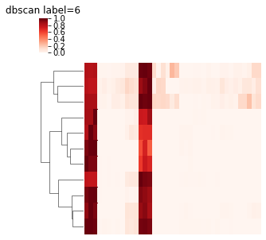
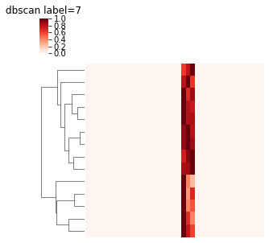
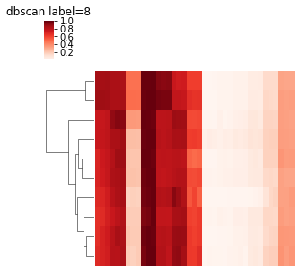
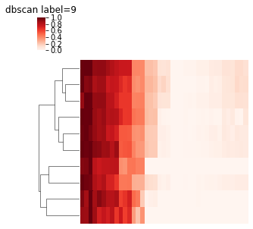
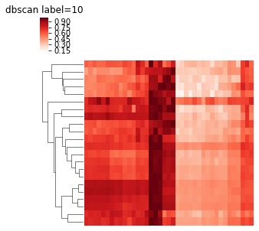
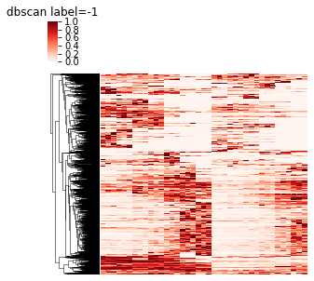

Slide 9
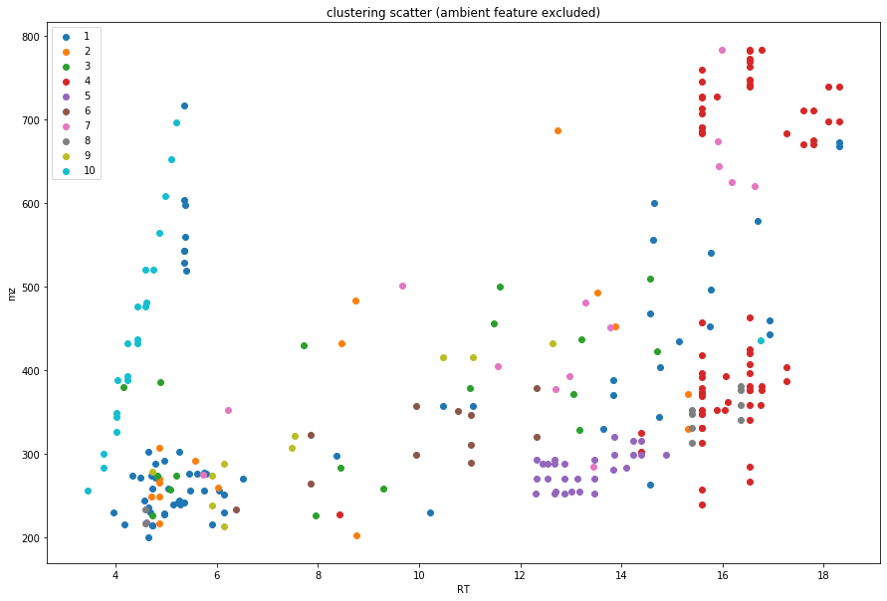

Slide 10
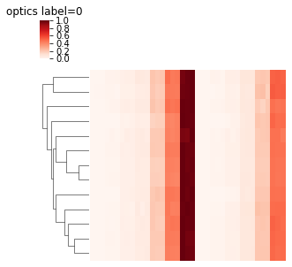
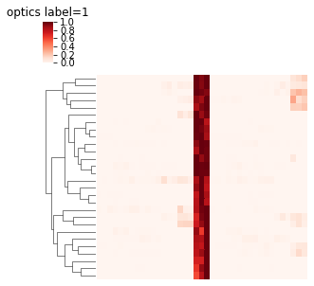
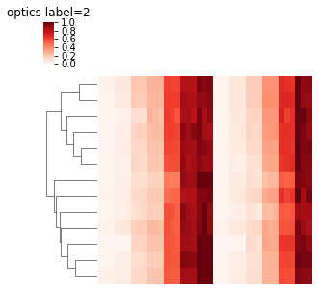
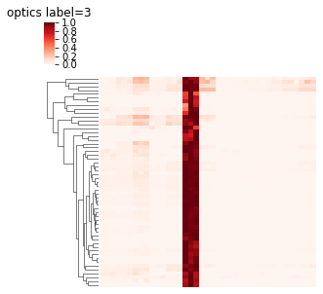
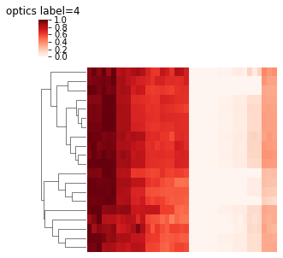
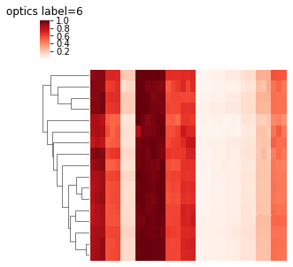
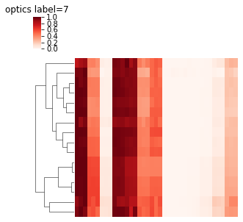
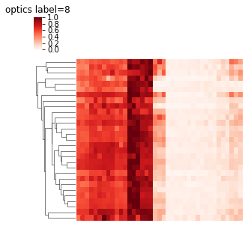
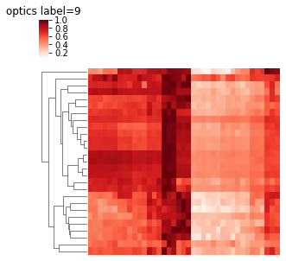
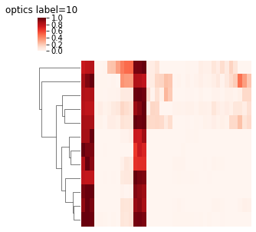
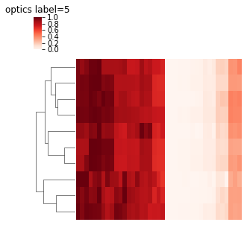
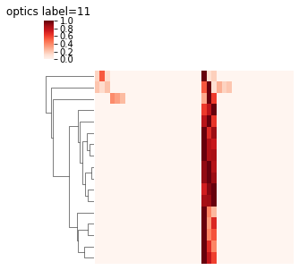
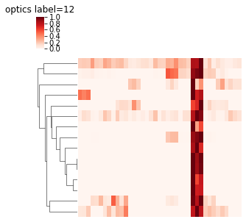
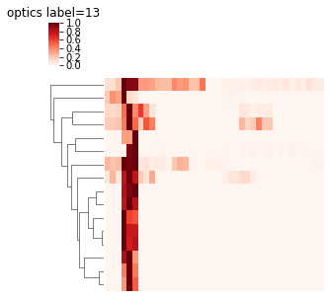
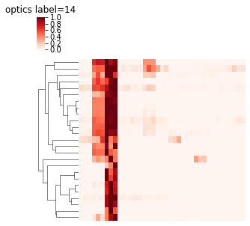
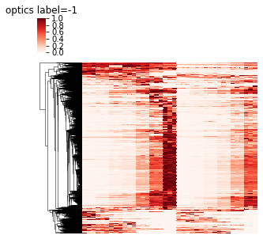

Slide 11
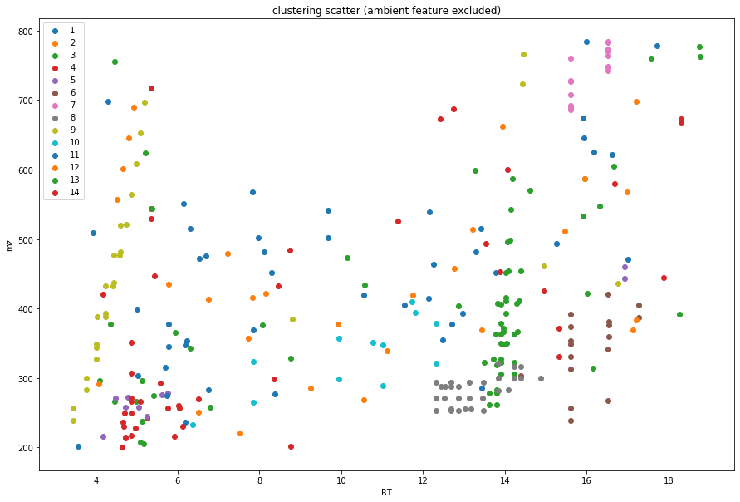

Slide 12

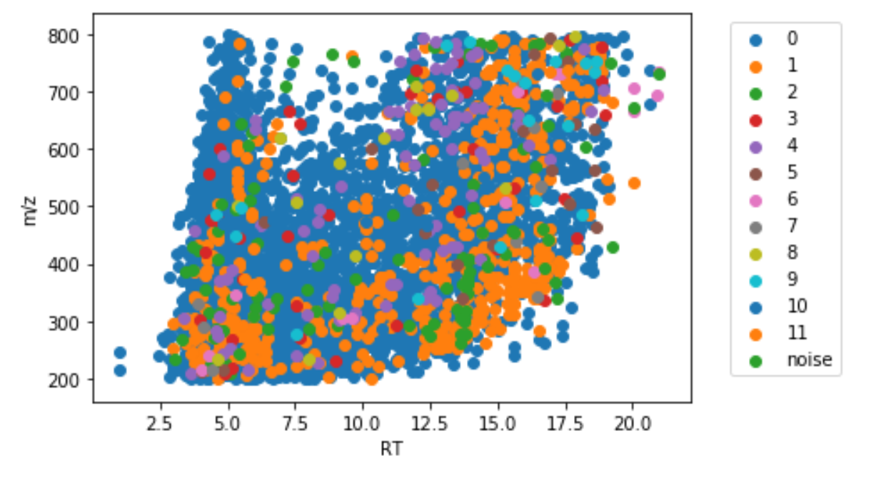
TREND CLUSTER
Basis uses non-parametric hypothesis tests for trend
Currently supporting: pearsonr, mannwhitneyu, Kruskal
Using the hypothesis test to find similar trends by pairwise comparison
Example using pearsonr test:
Majority of features reside in the first cluster
Intensity linearly depends on concentration

Slide 13
Modeling
Build model based on dilution dataset and cluster information
More accurate dilution rate prediction based on selected feature entity rather than single one
Save the model for clusters which could be used for matrix effect assessment
Only used source feature – make it possible to do approximate dilution calc based on even environmental samples
Challenge:
Validation
Data size

Slide 14
Options for user -- flowchart
General function
Rf/lasso/other
Linear regression
Use cluster
Use cluster
Use all features
Use all features
Ensemble method
Separate model information & report
Separate model information & report
Performance report
Performance report
Performance report
Merged model
Merged model

Slide 15
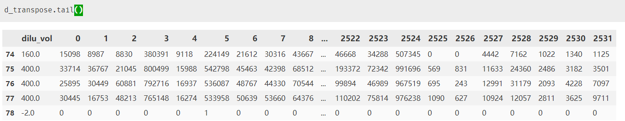
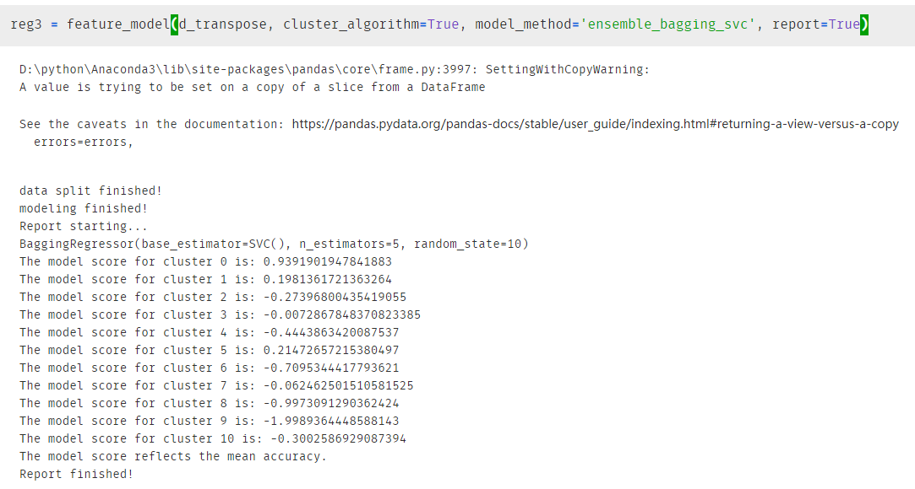
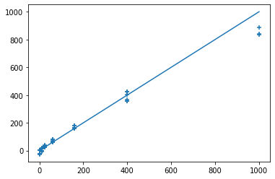
*Under development, not the final version

Slide 16
Prediction based on multiple clusters
Based on the cluster information and model score, user can pick individual clusters for prediction, the result will be combined either use size-based weight or simple average.

Slide 17
Flow chart for source ID process
Pretreat
Calculate means and CV from triplicates
Label
Labeling the features according to peak area threshold
ID and prem track
Using the label for preliminary ID and area tracking
Define mixture/source samples
Source & feature tracking (future)
Combine the information from the modeling data and cluster information

Slide 18
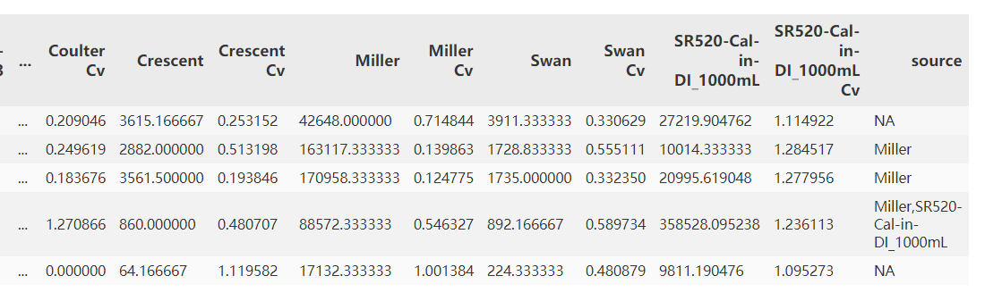
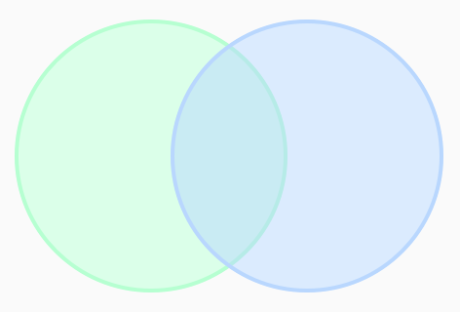
Quick source ID based on Venn diagram idea
Providing a quick & easy way to track sources
Possible to utilize the cluster information to improve the source tracking process
More detailed report
Challenge:
Matrix effect
Unknown environmental samples
noise
Source1
(area > thres)
Source
1 & 2
Source2
(area > thres)

Slide 19
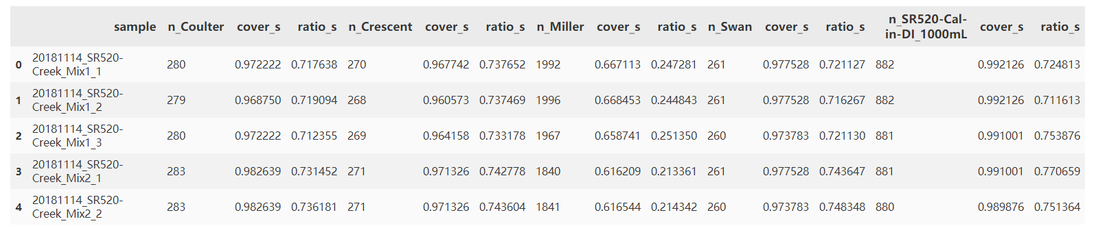
N_sample:
feature numbers that above the threshold
Cover_s:
coverage score from n_sample vs n_source
Ratio_s:
feature pairwise peak area ratio mean

Slide 20
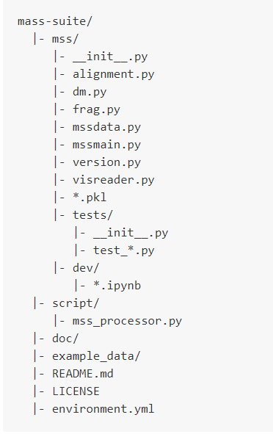
Documentation & Testing
Major documentation is now in the README of the repo
https://github.com/XiminHu/mass-suite
Unittest and Travis CI is incorporated to make sure the package pass through without hitch

Slide 21
Tasks to solve
Validation on larger/new dataset
Method optimization

Slide 22
Next & future dev
Test & validation
Function and Method
Test & validate the capability of this modeling method on environmental samples
Link the cluster & model information to the matrix effect and source tracking approach
Use the information for comprehensive quantification/monitoring of environmental pollutant (i.e. quantifying the source rather than single compound)
Tool
Finish the suite tool – make it a flexible & fully functional pipline
GUI/webtool on visualization and for non-programmer users
Dynamically update according to needs
doing the ‘minus’
Understand chemical commonality behind clusters

Slide 23
Thank you!

